Slide 1
Thinking in Objects

Slide 2
Motivations
You see the advantages of object-oriented programming from the preceding two chapters. This chapter will demonstrate how to solve problems using the object-oriented paradigm. Before studying these examples, we first introduce several language features for supporting these examples.

Slide 3
Immutable Objects and Classes
If the contents of an object cannot be changed once the object is created, the object is called an immutable object and its class is called an immutable class. If you delete the set method in the Circle class in the preceding example, the class would be immutable because radius is private and cannot be changed without a set method.
A class with all private data fields and without mutators is not necessarily immutable. For example, the following class Student has all private data fields and no mutators, but it is mutable.

Slide 4
Example
public class BirthDate {
private int year;
private int month;
private int day;
public BirthDate(int newYear,
int newMonth, int newDay) {
year = newYear;
month = newMonth;
day = newDay;
}
public void setYear(int newYear) {
year = newYear;
}
}
public class Student {
private int id;
private BirthDate birthDate;
public Student(int ssn,
int year, int month, int day) {
id = ssn;
birthDate = new BirthDate(year, month, day);
}
public int getId() {
return id;
}
public BirthDate getBirthDate() {
return birthDate;
}
}
public class Test {
public static void main(String[] args) {
Student student = new Student(111223333, 1970, 5, 3);
BirthDate date = student.getBirthDate();
date.setYear(2010); // Now the student birth year is changed!
}
}

Slide 5
What Class is Immutable?
For a class to be immutable, it must mark all data fields private and provide no mutator methods and no accessor methods that would return a reference to a mutable data field object.

Slide 6
Scope of Variables
The scope of instance and static variables is the entire class. They can be declared anywhere inside a class.
The scope of a local variable starts from its declaration and continues to the end of the block that contains the variable. A local variable must be initialized explicitly before it can be used.

Slide 7
The this Keyword
The this keyword is the name of a reference that refers to an object itself. One common use of the this keyword is reference a class’s hidden data fields.
Another common use of the this keyword to enable a constructor to invoke another constructor of the same class.

Slide 8

Reference the Hidden Data Fields

Slide 9

Calling Overloaded Constructor

Slide 10

Class Abstraction and Encapsulation
Class abstraction means to separate class implementation from the use of the class. The creator of the class provides a description of the class and let the user know how the class can be used. The user of the class does not need to know how the class is implemented. The detail of implementation is encapsulated and hidden from the user.

Slide 11
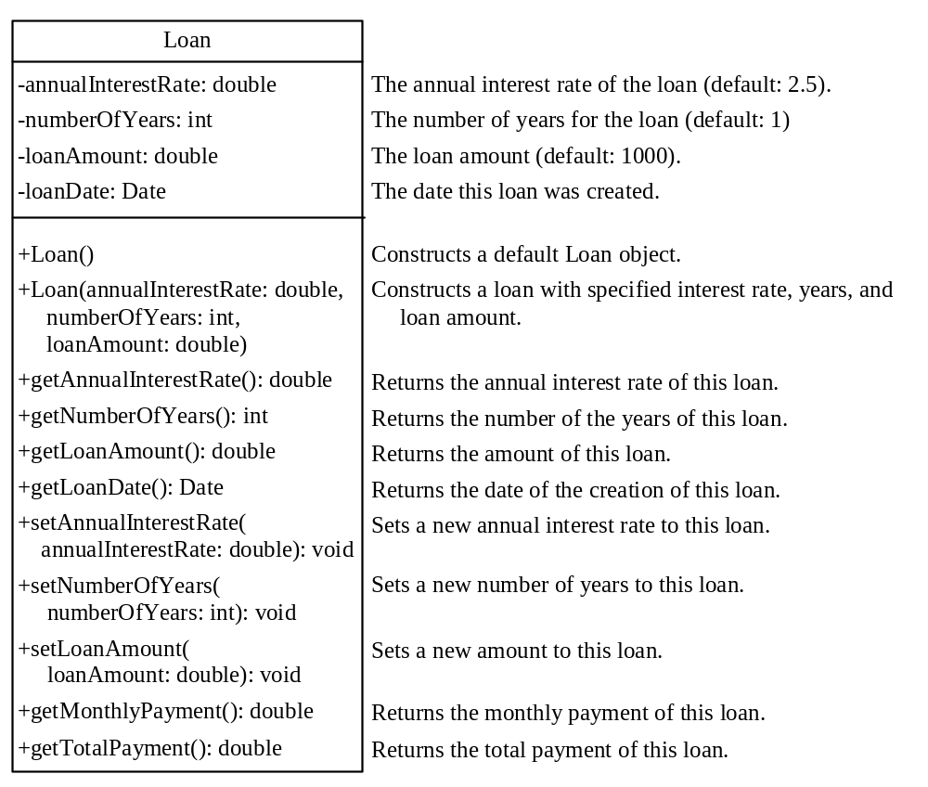
Designing the Loan Class
Loan
TestLoanClass

Slide 12
Object-Oriented Thinking
Chapters 1-7 introduced fundamental programming techniques for problem solving using loops, methods, and arrays. The studies of these techniques lay a solid foundation for object-oriented programming. Classes provide more flexibility and modularity for building reusable software. This section improves the solution for a problem introduced in Chapter 3 using the object-oriented approach. From the improvements, you will gain the insight on the differences between the procedural programming and object-oriented programming and see the benefits of developing reusable code using objects and classes.

Slide 13
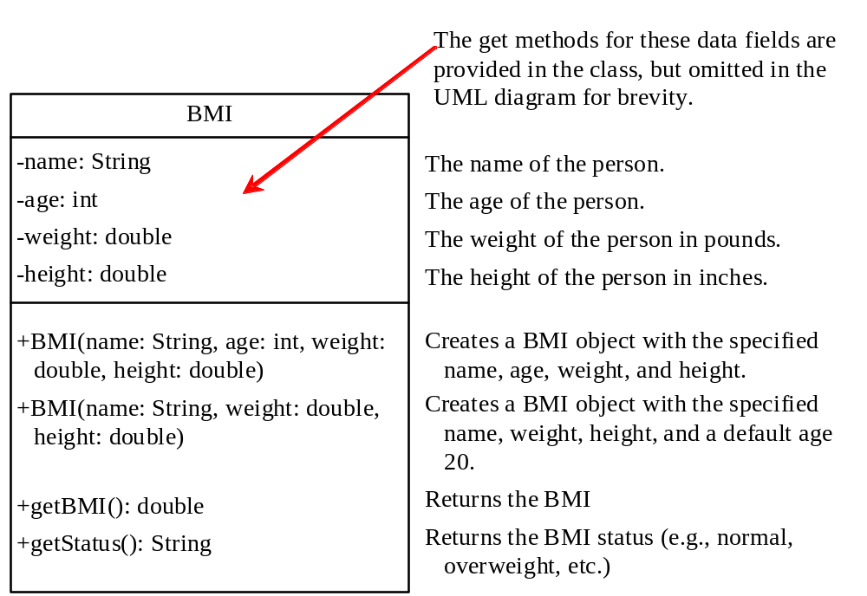
The BMI Class
BMI
UseBMIClass

Slide 14
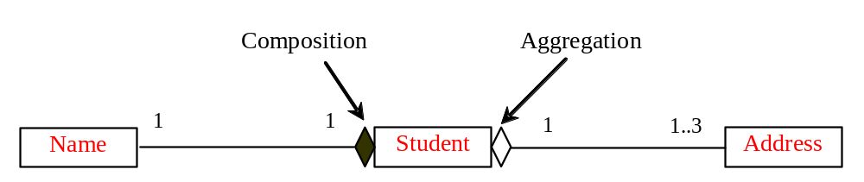
Object Composition
Composition is actually a special case of the aggregation relationship. Aggregation models has-a relationships and represents an ownership relationship between two objects. The owner object is called an aggregating object and its class an aggregating class. The subject object is called an aggregated object and its class an aggregated class.

Slide 15
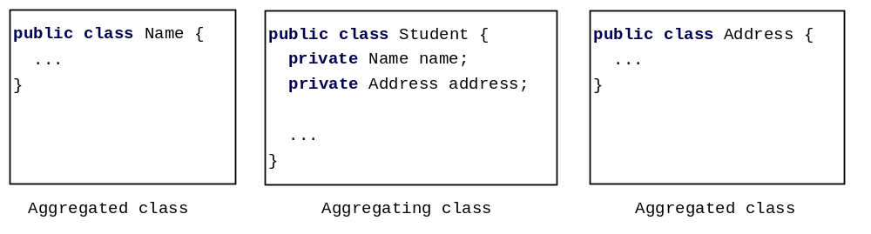
Class Representation
An aggregation relationship is usually represented as a data field in the aggregating class. For example, the relationship in Figure 10.6 can be represented as follows:

Slide 16
Aggregation or Composition
Since aggregation and composition relationships are represented using classes in similar ways, many texts don’t differentiate them and call both compositions.

Slide 17

Aggregation Between Same Class
Aggregation may exist between objects of the same class. For example, a person may have a supervisor.
public class Person {
// The type for the data is the class itself
private Person supervisor;
...
}

Slide 18
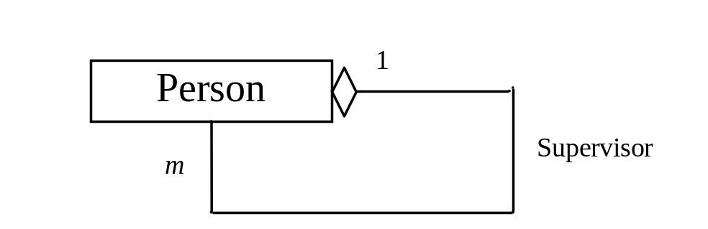
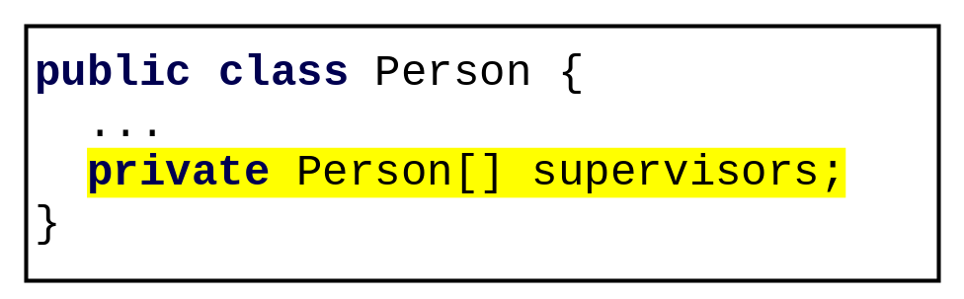
Aggregation Between Same Class
What happens if a person has several supervisors?

Slide 19
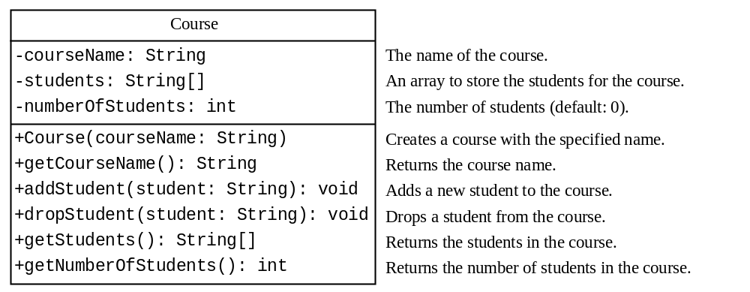
Example: The Course Class
Course
TestCourse

Slide 20

Example: The StackOfIntegers Class
TestStackOfIntegers

Slide 21
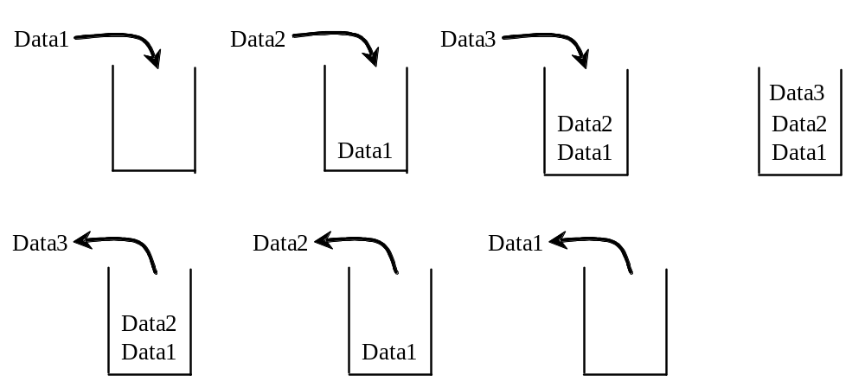
Designing the StackOfIntegers Class

Slide 22
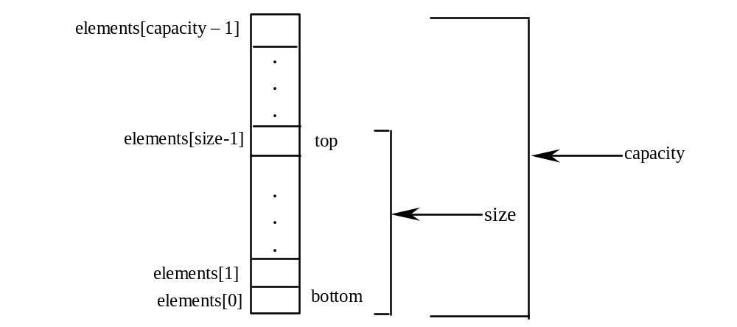
Implementing StackOfIntegers Class
StackOfIntegers

Slide 23
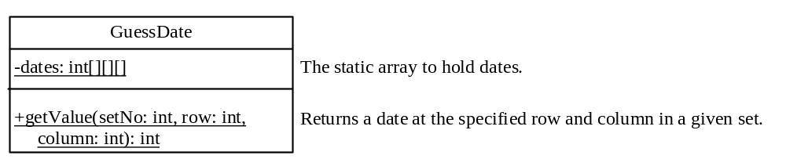
Designing the GuessDate Class
GuessDate
UseGuessDateClass

Slide 24
Designing a Class
(Coherence) A class should describe a single entity, and all the class operations should logically fit together to support a coherent purpose. You can use a class for students, for example, but you should not combine students and staff in the same class, because students and staff have different entities.

Slide 25
Designing a Class, cont.
(Separating responsibilities) A single entity with too many responsibilities can be broken into several classes to separate responsibilities. The classes String, StringBuilder, and StringBuffer all deal with strings, for example, but have different responsibilities. The String class deals with immutable strings, the StringBuilder class is for creating mutable strings, and the StringBuffer class is similar to StringBuilder except that StringBuffer contains synchronized methods for updating strings.

Slide 26
Designing a Class, cont.
Classes are designed for reuse. Users can incorporate classes in many different combinations, orders, and environments. Therefore, you should design a class that imposes no restrictions on what or when the user can do with it, design the properties to ensure that the user can set properties in any order, with any combination of values, and design methods to function independently of their order of occurrence.

Slide 27
Designing a Class, cont.
Provide a public no-arg constructor and override the equals method and the toString method defined in the Object class whenever possible.

Slide 28
Designing a Class, cont.
Follow standard Java programming style and naming conventions. Choose informative names for classes, data fields, and methods. Always place the data declaration before the constructor, and place constructors before methods. Always provide a constructor and initialize variables to avoid programming errors.

Slide 29
Using Visibility Modifiers
Each class can present two contracts – one for the users of the class and one for the extenders of the class. Make the fields private and accessor methods public if they are intended for the users of the class. Make the fields or method protected if they are intended for extenders of the class. The contract for the extenders encompasses the contract for the users. The extended class may increase the visibility of an instance method from protected to public, or change its implementation, but you should never change the implementation in a way that violates that contract.

Slide 30
Using Visibility Modifiers, cont.
A class should use the private modifier to hide its data from direct access by clients. You can use get methods and set methods to provide users with access to the private data, but only to private data you want the user to see or to modify. A class should also hide methods not intended for client use. The gcd method in the Rational class in Example 11.2, “The Rational Class,” is private, for example, because it is only for internal use within the class.

Slide 31
Using the static Modifier
A property that is shared by all the instances of the class should be declared as a static property.

Slide 32
Wrapper Classes
Boolean
Character
Short
Byte
Integer
Long
Float
Double
NOTE: (1) The wrapper classes do not have no-arg constructors. (2) The instances of all wrapper classes are immutable, i.e., their internal values cannot be changed once the objects are created.

Slide 33
The toString, equals, and hashCode Methods
Each wrapper class overrides the toString, equals, and hashCode methods defined in the Object class. Since all the numeric wrapper classes and the Character class implement the Comparable interface, the compareTo method is implemented in these classes.

Slide 34
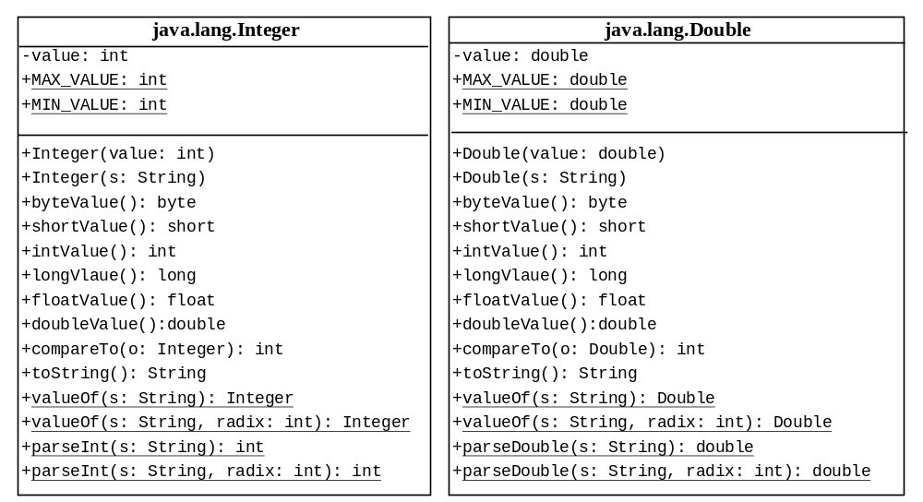
The Integer and Double Classes

Slide 35
The Integer Class and the Double Class
Constructors
Class Constants MAX_VALUE, MIN_VALUE
Conversion Methods

Slide 36
Numeric Wrapper Class Constructors
You can construct a wrapper object either from a primitive data type value or from a string representing the numeric value. The constructors for Integer and Double are:
  public Integer(int value)
  public Integer(String s)
  public Double(double value)
  public Double(String s)

Slide 37
Numeric Wrapper Class Constants
Each numerical wrapper class has the constants MAX_VALUE and MIN_VALUE. MAX_VALUE represents the maximum value of the corresponding primitive data type. For Byte, Short, Integer, and Long, MIN_VALUE represents the minimum byte, short, int, and long values. For Float and Double, MIN_VALUE represents the minimum positive float and double values. The following statements display the maximum integer (2,147,483,647), the minimum positive float (1.4E-45), and the maximum double floating-point number (1.79769313486231570e+308d).

Slide 38
Conversion Methods
Each numeric wrapper class implements the abstract methods doubleValue, floatValue, intValue, longValue, and shortValue, which are defined in the Number class. These methods “convert” objects into primitive type values.

Slide 39
The Static valueOf Methods
The numeric wrapper classes have a useful class method, valueOf(String s). This method creates a new object initialized to the value represented by the specified string. For example:
  Double doubleObject = Double.valueOf("12.4");
  Integer integerObject = Integer.valueOf("12");

Slide 40
The Methods for Parsing Strings into Numbers
You have used the parseInt method in the Integer class to parse a numeric string into an int value and the parseDouble method in the Double class to parse a numeric string into a double value. Each numeric wrapper class has two overloaded parsing methods to parse a numeric string into an appropriate numeric value.

Slide 41
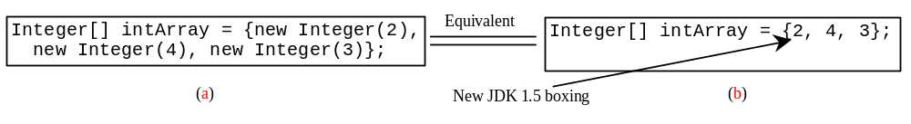
Automatic Conversion Between Primitive Types and Wrapper Class Types
JDK 1.5 allows primitive type and wrapper classes to be converted automatically. For example, the following statement in (a) can be simplified as in (b):
Integer[] intArray = {1, 2, 3};
System.out.println(intArray[0] + intArray[1] + intArray[2]);
Unboxing

Slide 42
BigInteger and BigDecimal
If you need to compute with very large integers or high precision floating-point values, you can use the BigInteger and BigDecimal classes in the java.math package. Both are immutable. Both extend the Number class and implement the Comparable interface.

Slide 43
BigInteger and BigDecimal
BigInteger a = new BigInteger("9223372036854775807");
BigInteger b = new BigInteger("2");
BigInteger c = a.multiply(b); // 9223372036854775807 * 2
System.out.println(c);
LargeFactorial
BigDecimal a = new BigDecimal(1.0);
BigDecimal b = new BigDecimal(3);
BigDecimal c = a.divide(b, 20, BigDecimal.ROUND_UP);
System.out.println(c);

